Slide 1

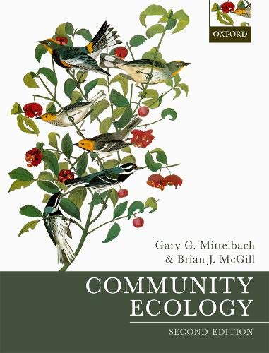
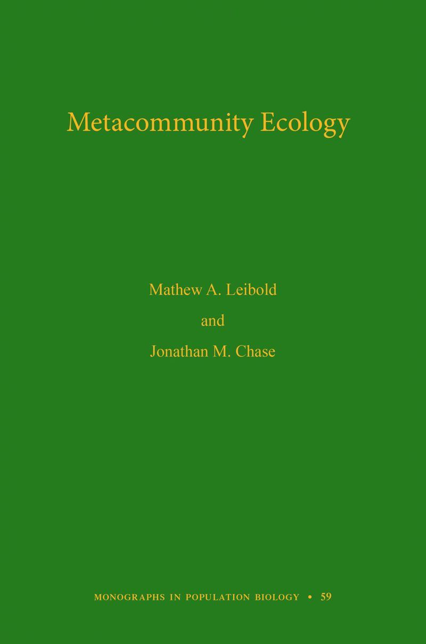

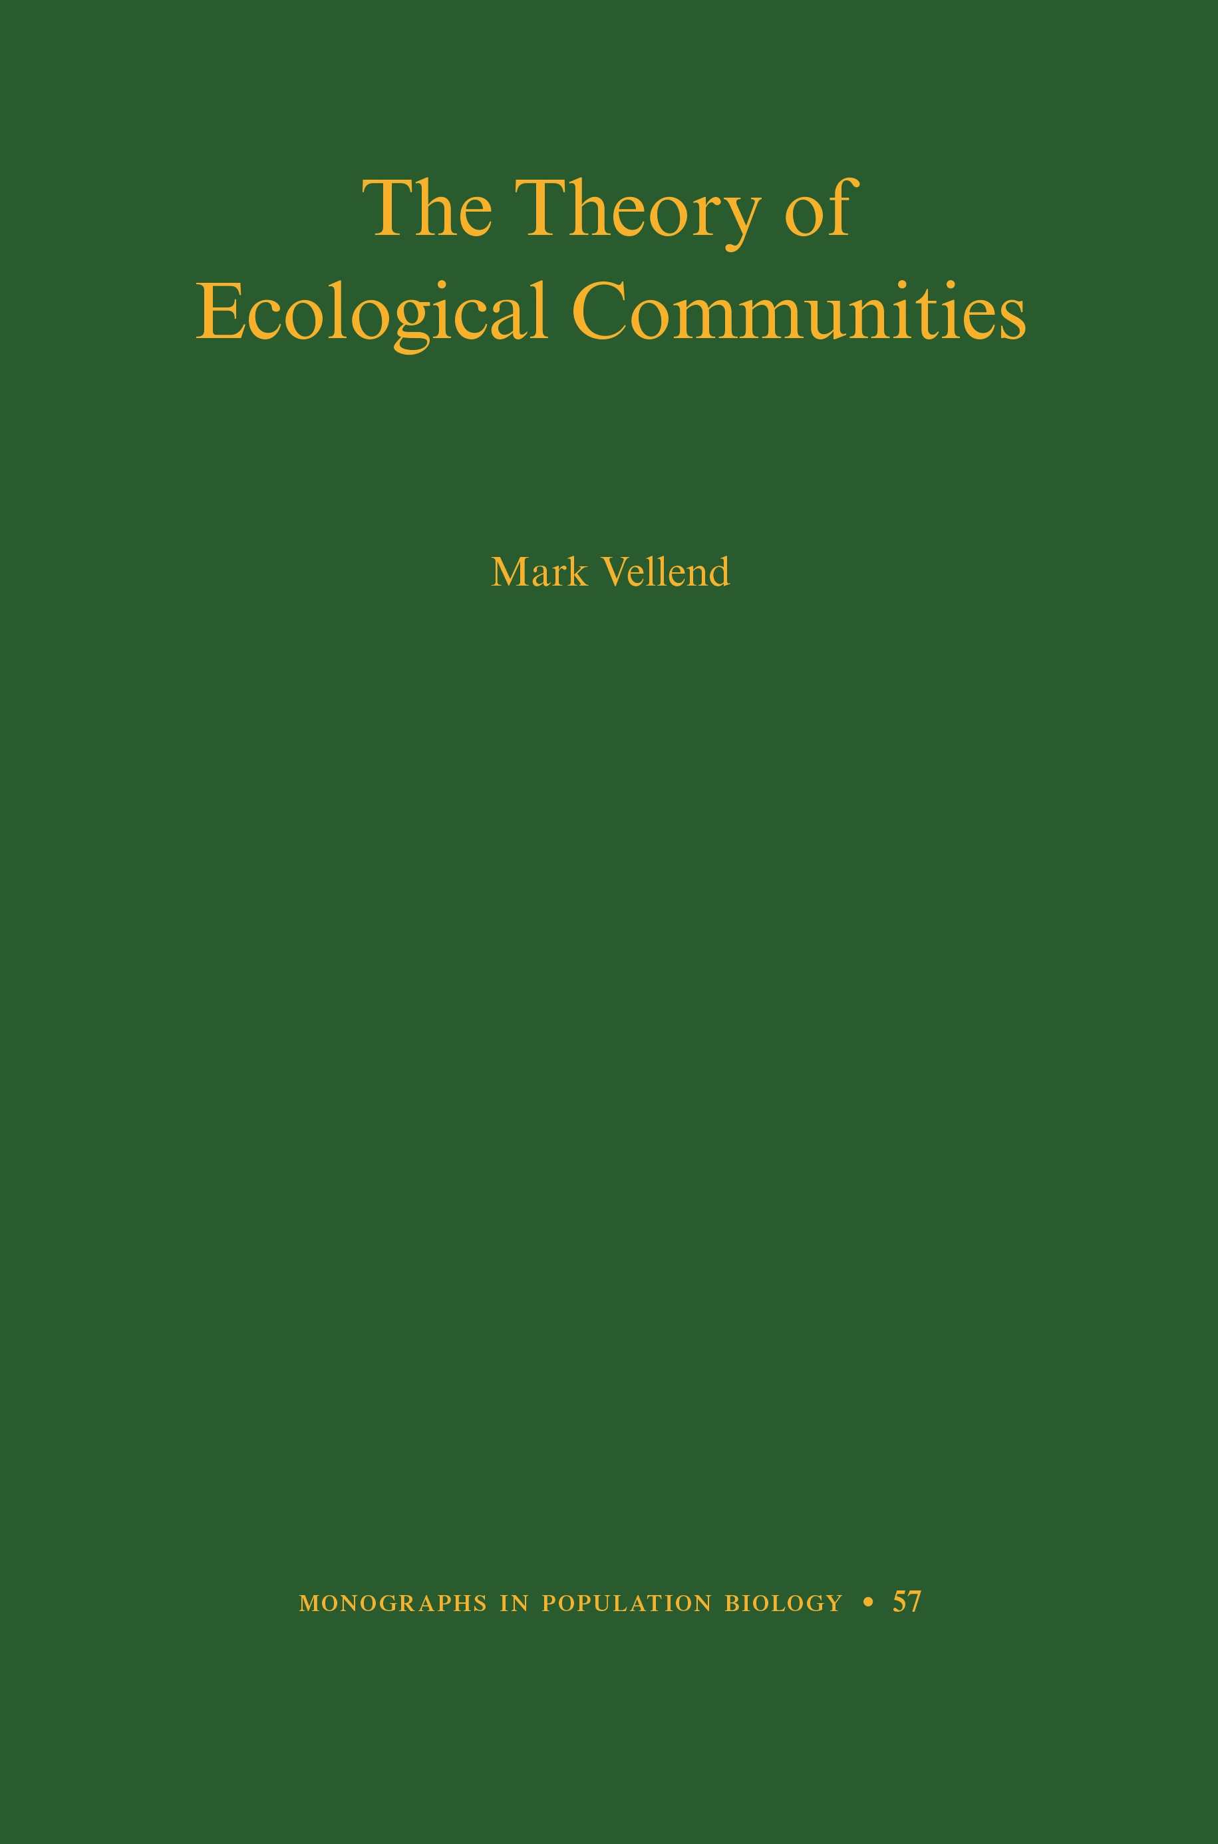
Prof. Jonathan Chase
jonathan.chase@idiv.de
Advanced Community Ecology Course at Peking University

Slide 2
Community ecology lies at the interface between population and ecosystems ecology, and thus provides a critical link between then.
Community ecology has become a central topic in the understanding of biodiversity and its change, as well as its role in ecosystem functioning and services, placing it among the most important of the ecological sciences for understanding Anthropocene changes.
The goal of this course is to expose students to the past, present and future of the dynamic and critically important field of community ecology.
Each session will consist of two 1 hour lectures and two 20 minute discussions and question period (with two breaks).
Background readings are given for students who would like a little more context for the lectures, but are not required for understanding the material.

Slide 3




Lecture 1:Community ecology as a discipline—history, questions, approaches
(A biased perspective)
@jon_chase03
jonathan.chase@idiv.de

Slide 4
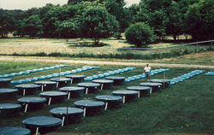
23 years ago…..A new PhD in
Community Ecology
“Community ecology may have the worst of all worlds…. It is not big and bold enough to break out of the overwhelming complexity…
…this begs the question of why ecologists continue to devote so much time and effort to traditional studies in community ecology. In my view, the time has come to move on”
“It Depends”

Slide 5
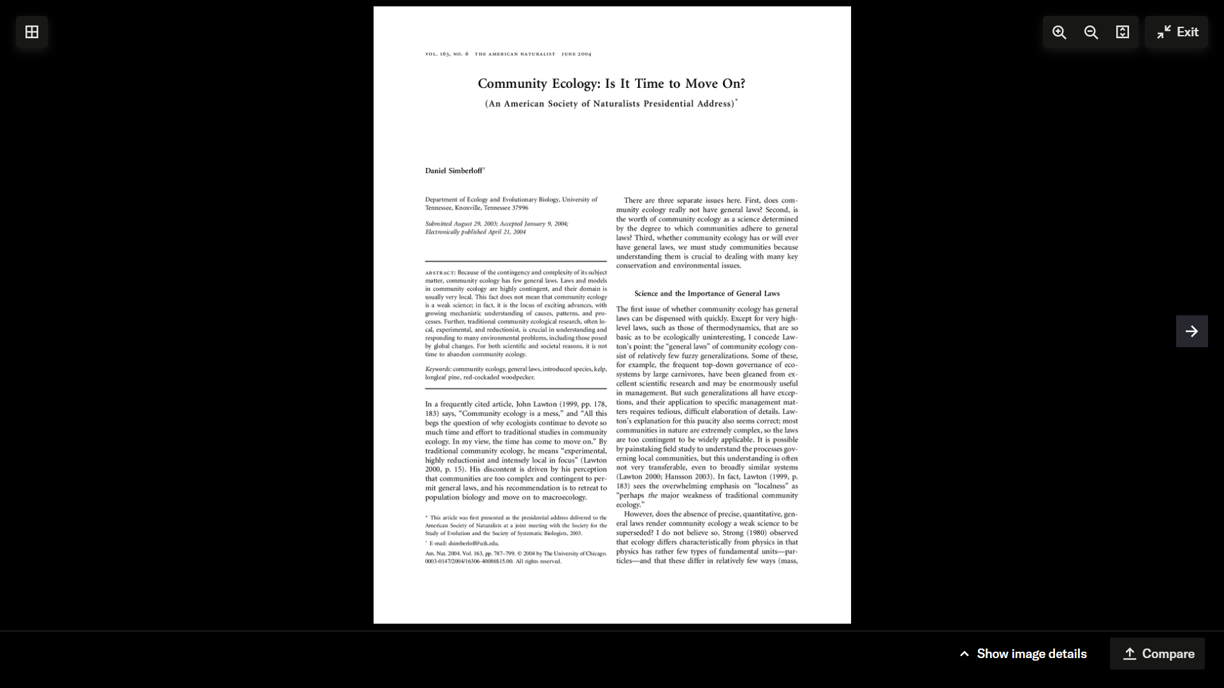
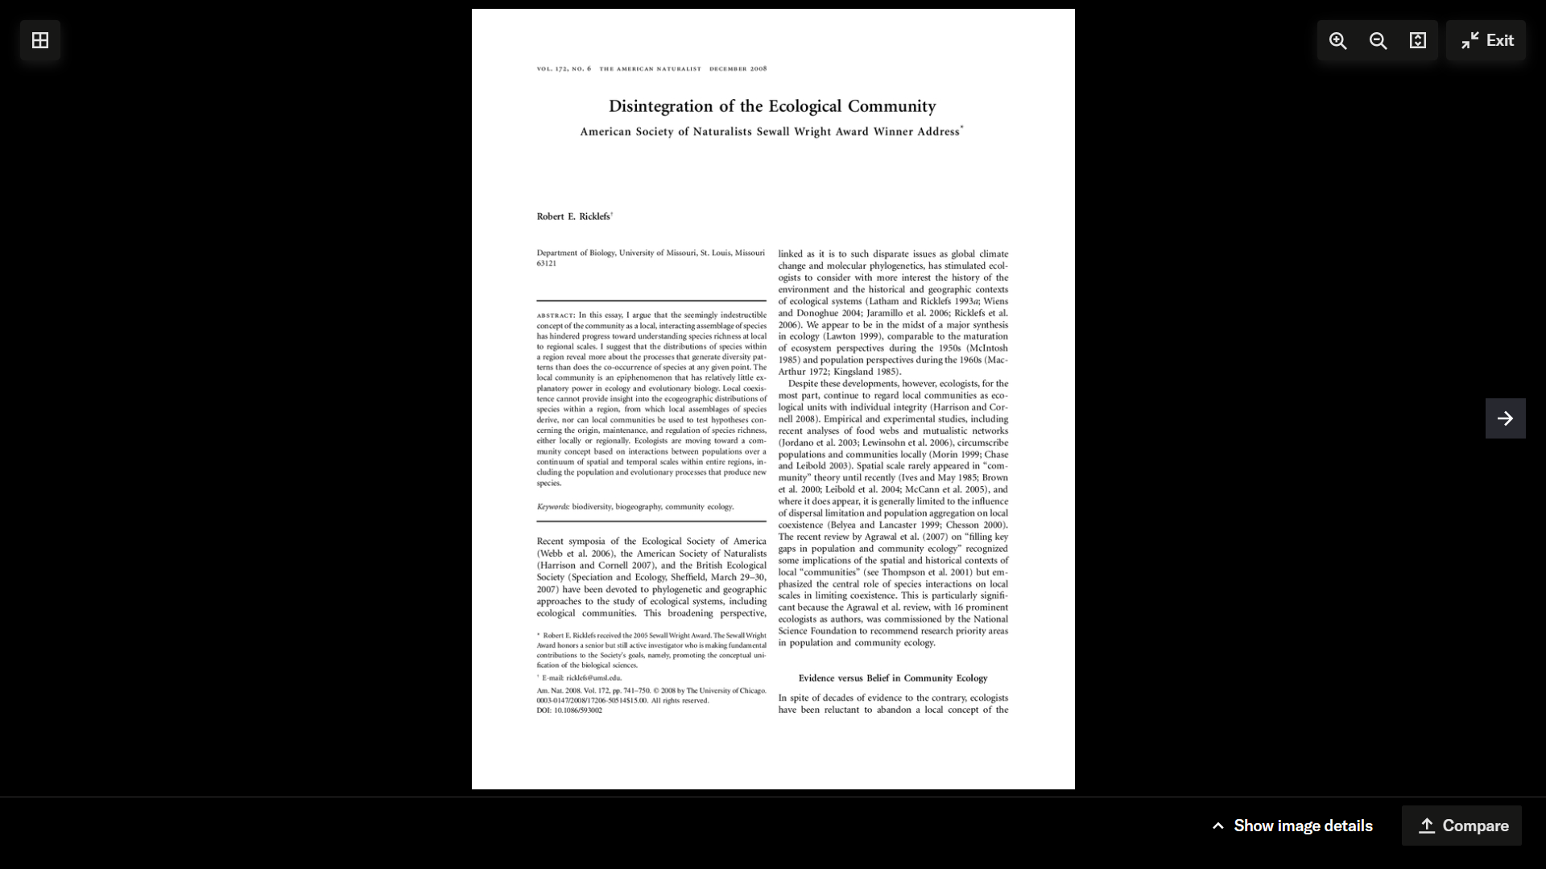
This fact does not mean that community ecology is a weak science; in fact, it is the locus of exciting advances, with growing mechanistic understanding of causes, patterns, and processes.
The seemingly indestructible concept of the community as a local, interacting assemblage of species has hindered progress toward understanding species richness at local to regional scales.

Slide 6
Community Ecology over the last 15-20+ years—Exciting Developments!
Integrating local and regional processes
Explicit focus on scale and scaling
Connections to macroecology
Focus on pattern/process integration
Integrating temporal patterns and processes
Stability, dynamics
Connections to applied problems—Biodiversity change
Integration of food webs, mutualisms, disease, parasites, etc.
BEF research becoming more sophisticated
Bi-directional processes, natural environments
Efforts towards synthesis (often big data)
Data standardization
Strong analytical tools
GLMM
Hierarchical modelling (Bayesian)
Machine learning

Slide 7
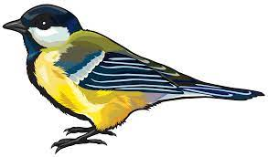

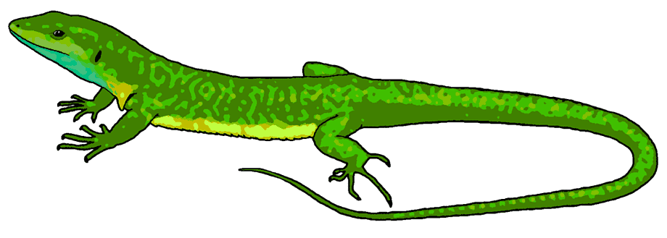

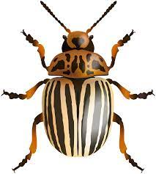


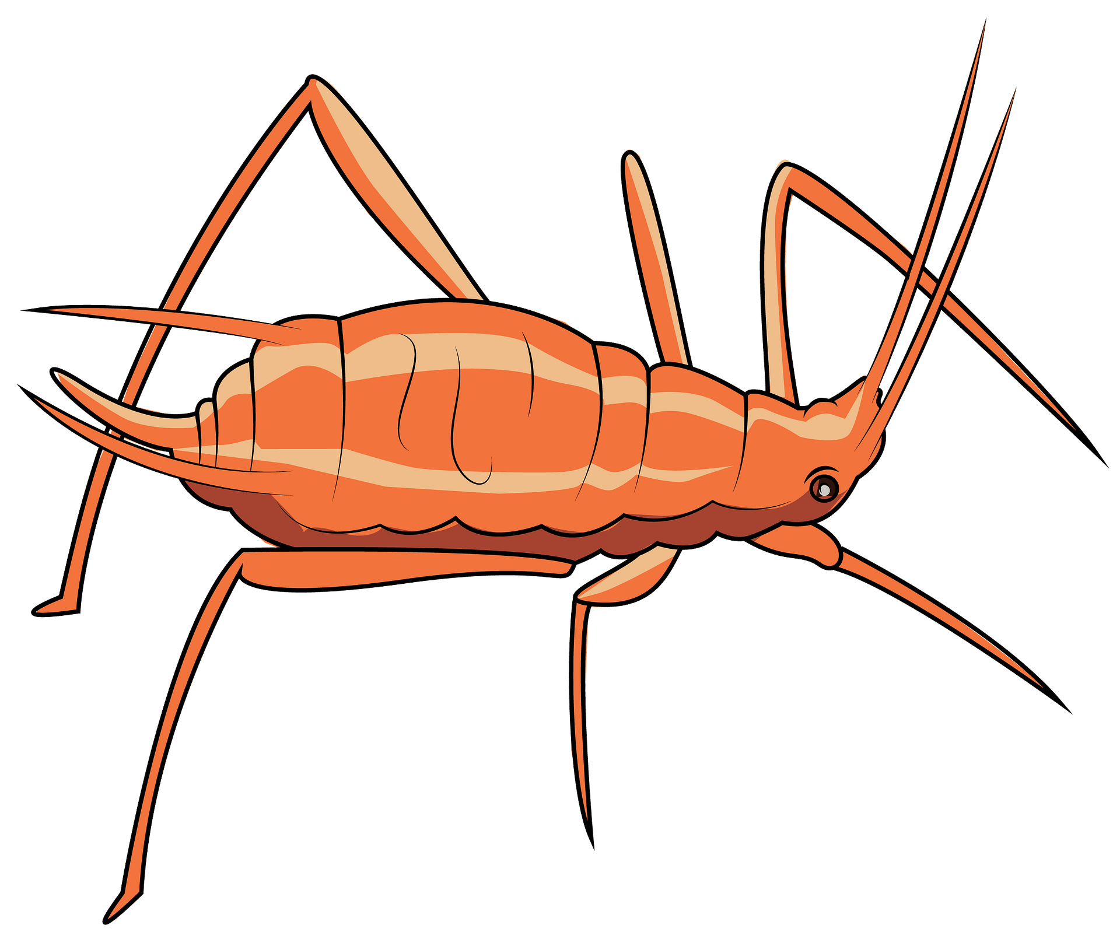
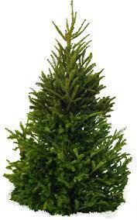
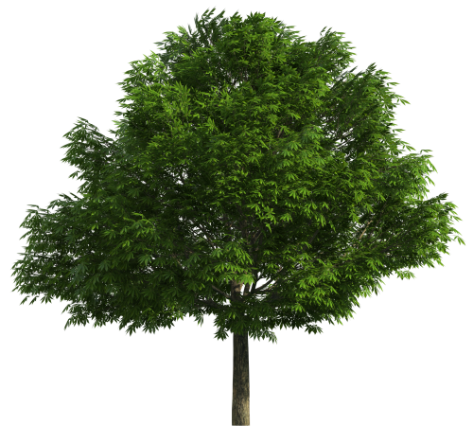

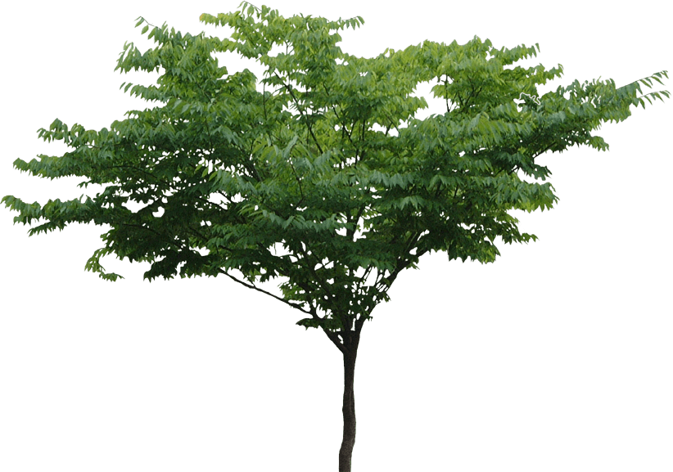
Organism/individual
Fitness
Behavior
Physiology
Etcetera
Population/ Metapopulation
Abundance
Growth/dynamics
Distribution
Time
Community/Metacommunity
Coexistence/Assembly
Richness/diversity/Evenness
Scale and Beta-Diversity
Change through time (stability)
Food Webs and trophic structure (also mutualisms)
Biodiversity and ecosystem functioning (BEF)
Ecosystem fluxes and cycles
Energy, Nutrients, water
Energy, Nutrients, water

Slide 8
A Brief (and Biased) View of the History of Community Ecology
Why is understanding the history of our field important?

Slide 9
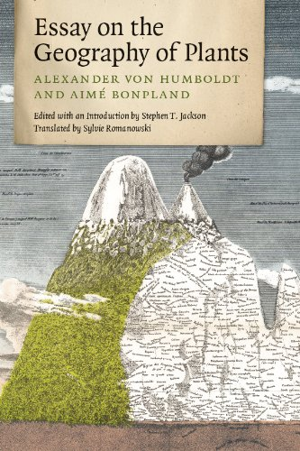
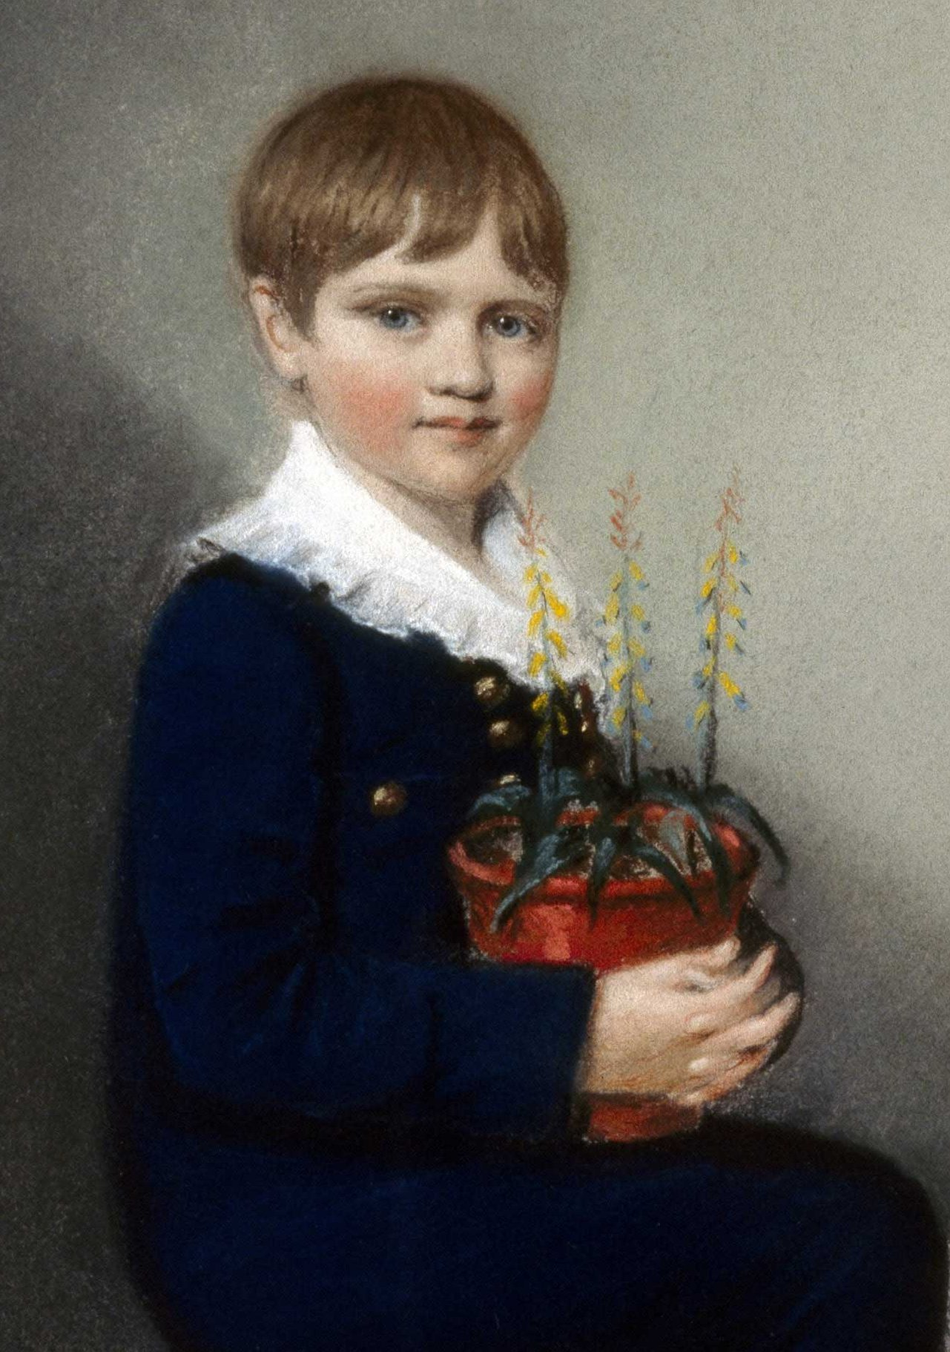
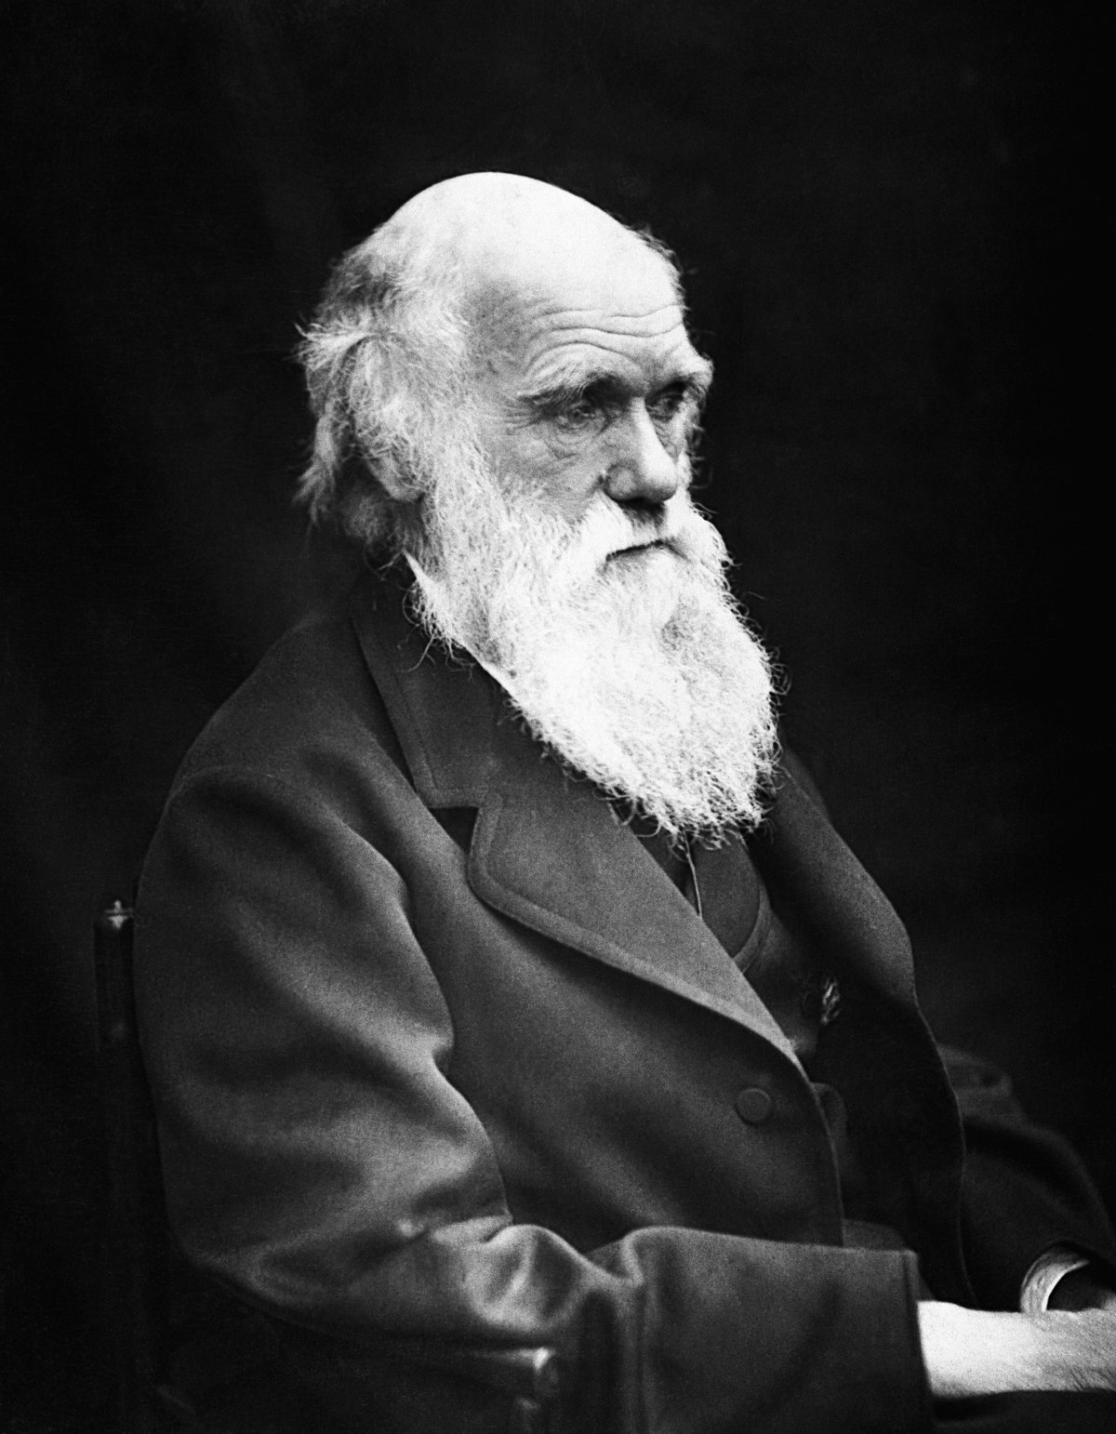
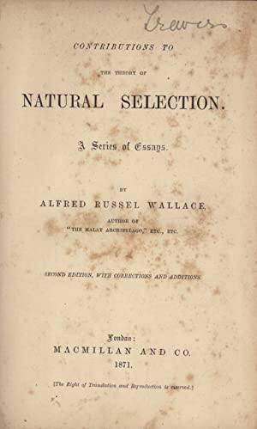
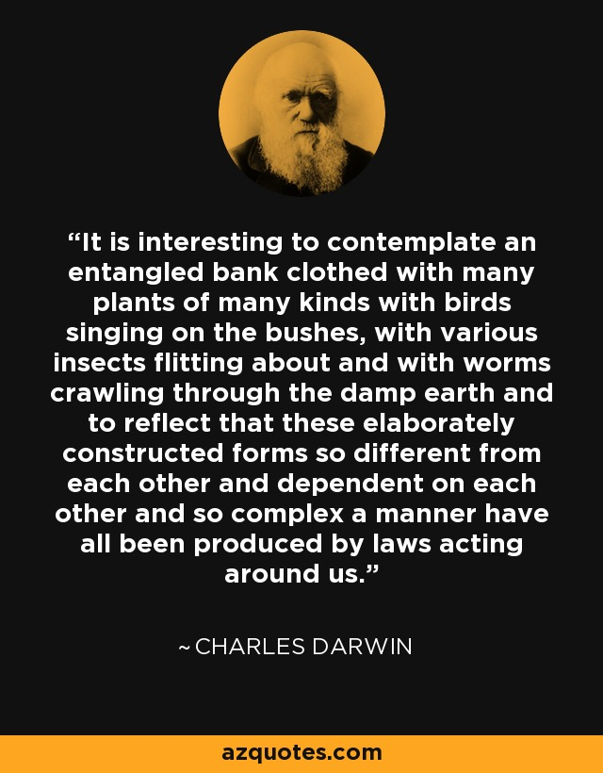
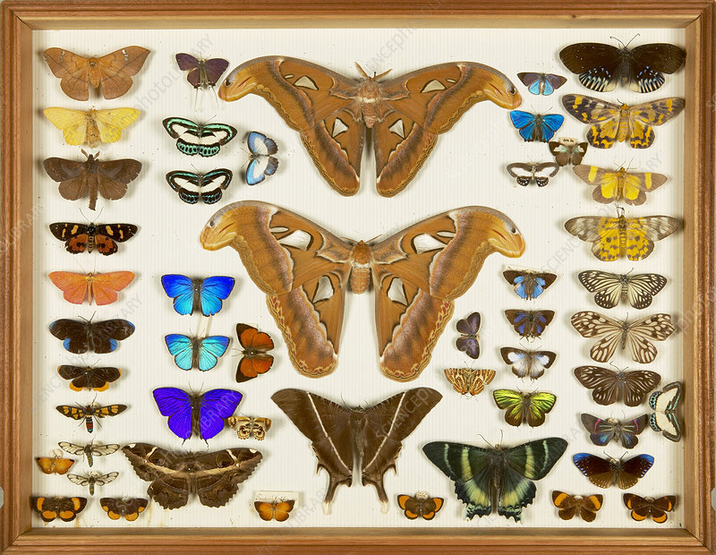
1859
1871
1807

Slide 10
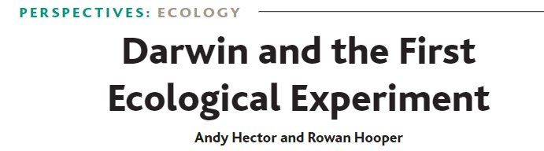
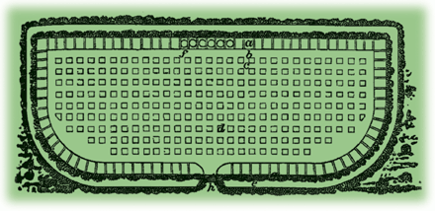
BEF history
2002
Hortus Gramineus, or grass garden, at Woburn Abbeyin 1817.
242 experimental plots
Greater diversity of plants→ Greater overall production (Published in 1826)
Cited in Darwin ‘Origin of Species’ as proof of the principle of ‘divergence’ (differences)

Slide 11
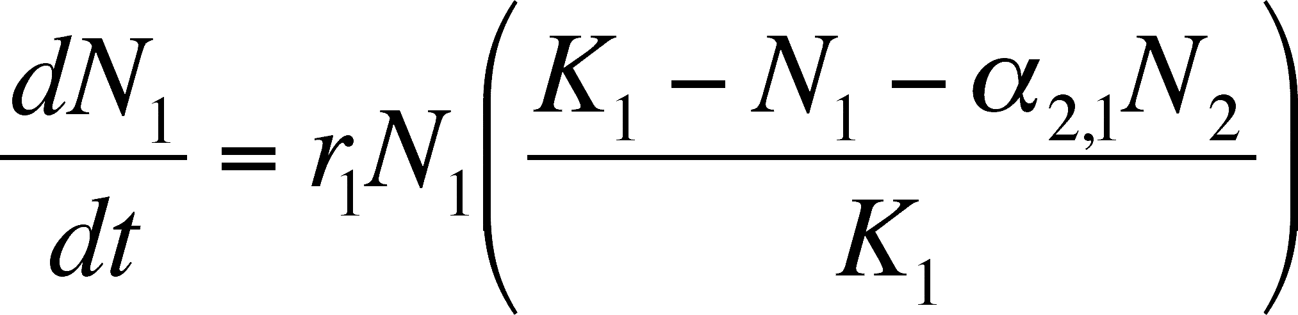
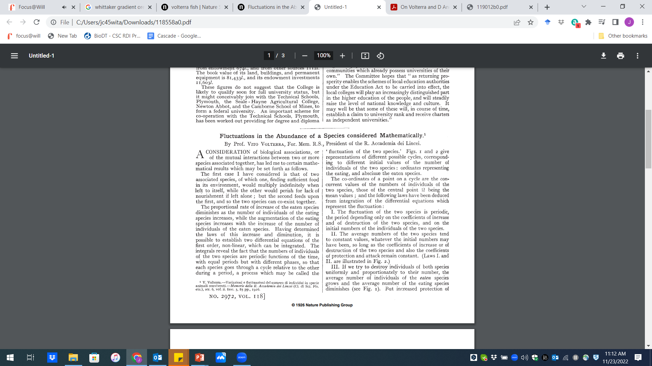
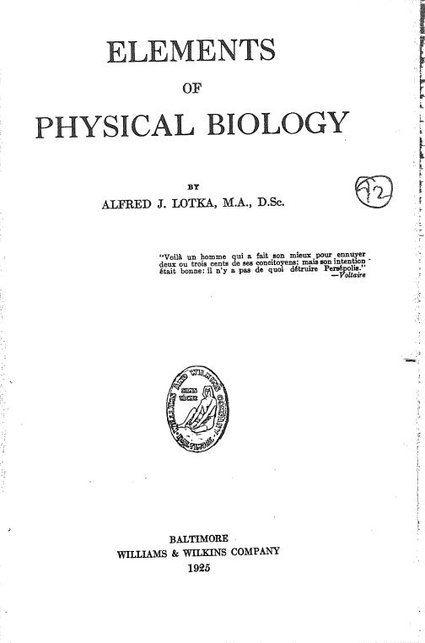
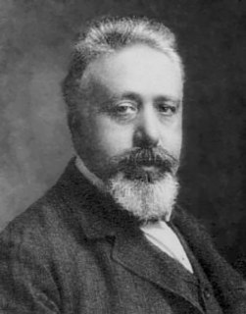
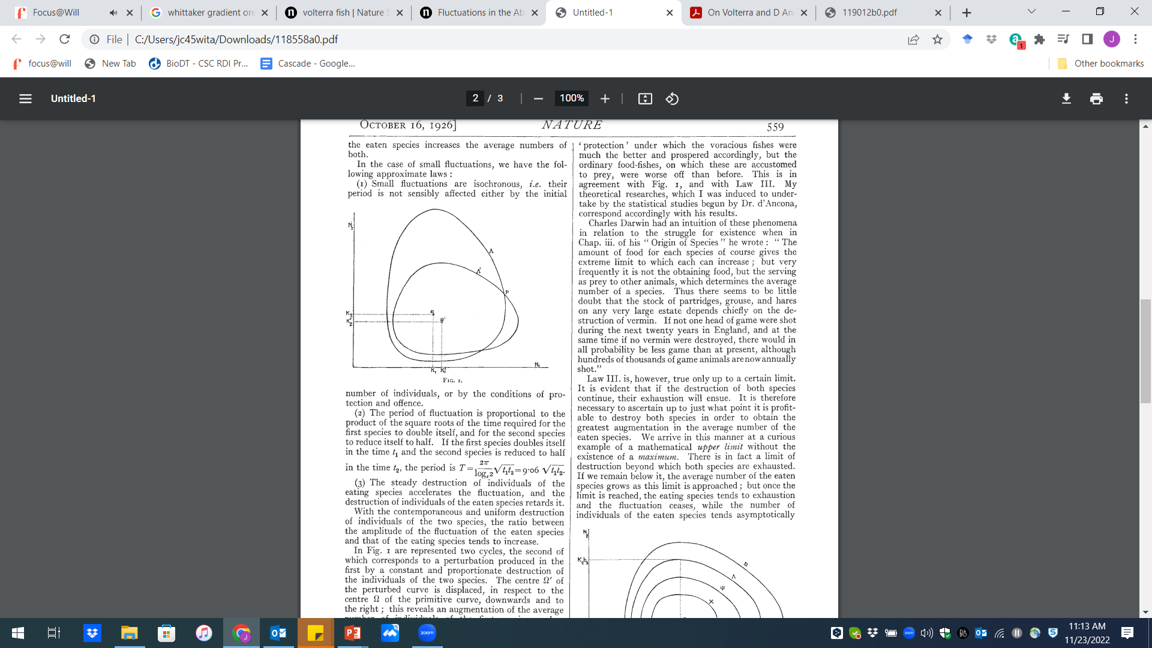
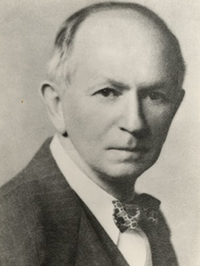
1920s

Slide 12
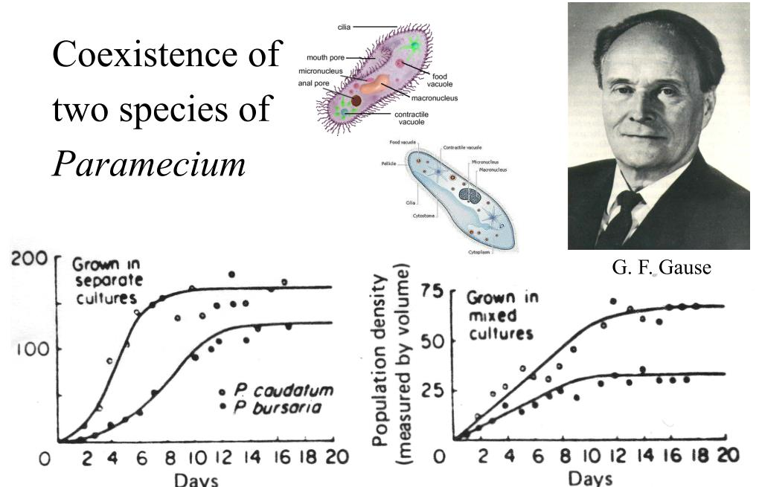
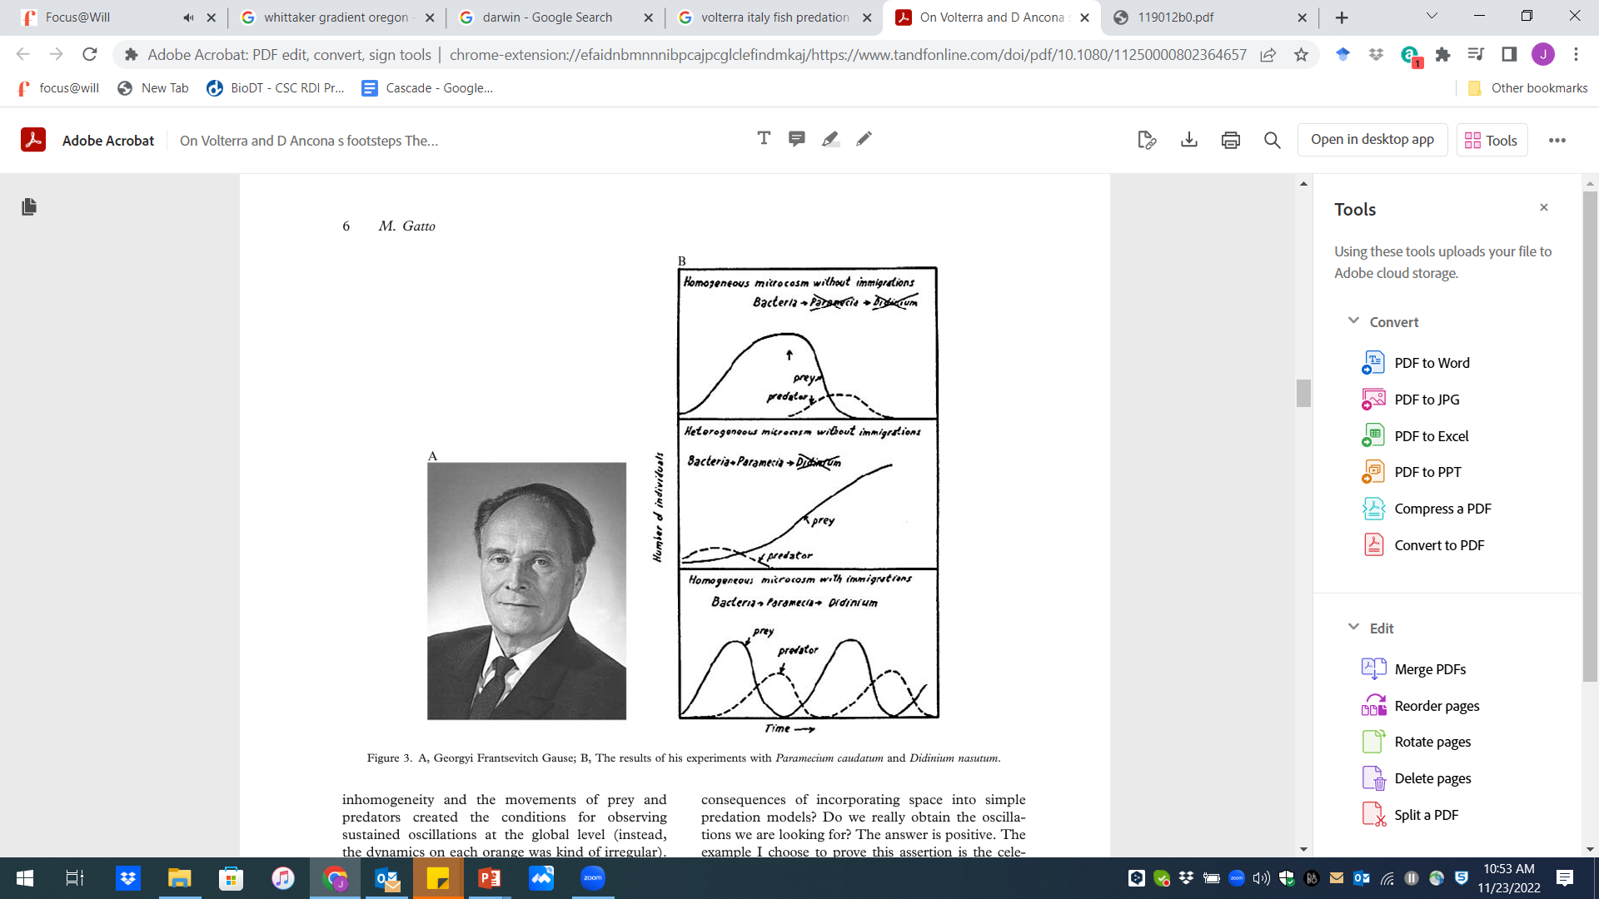

Slide 13
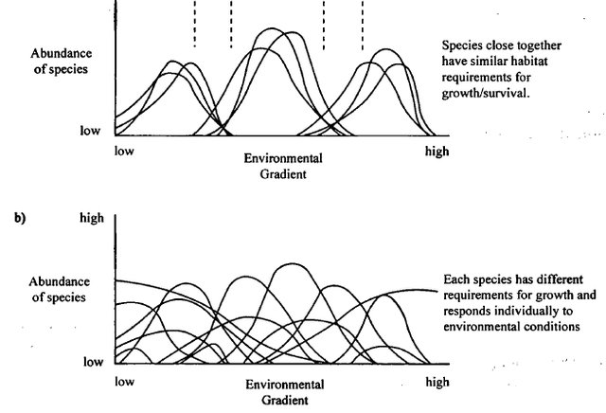
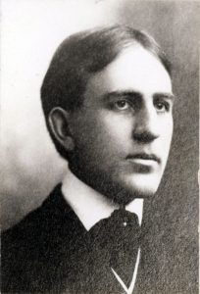
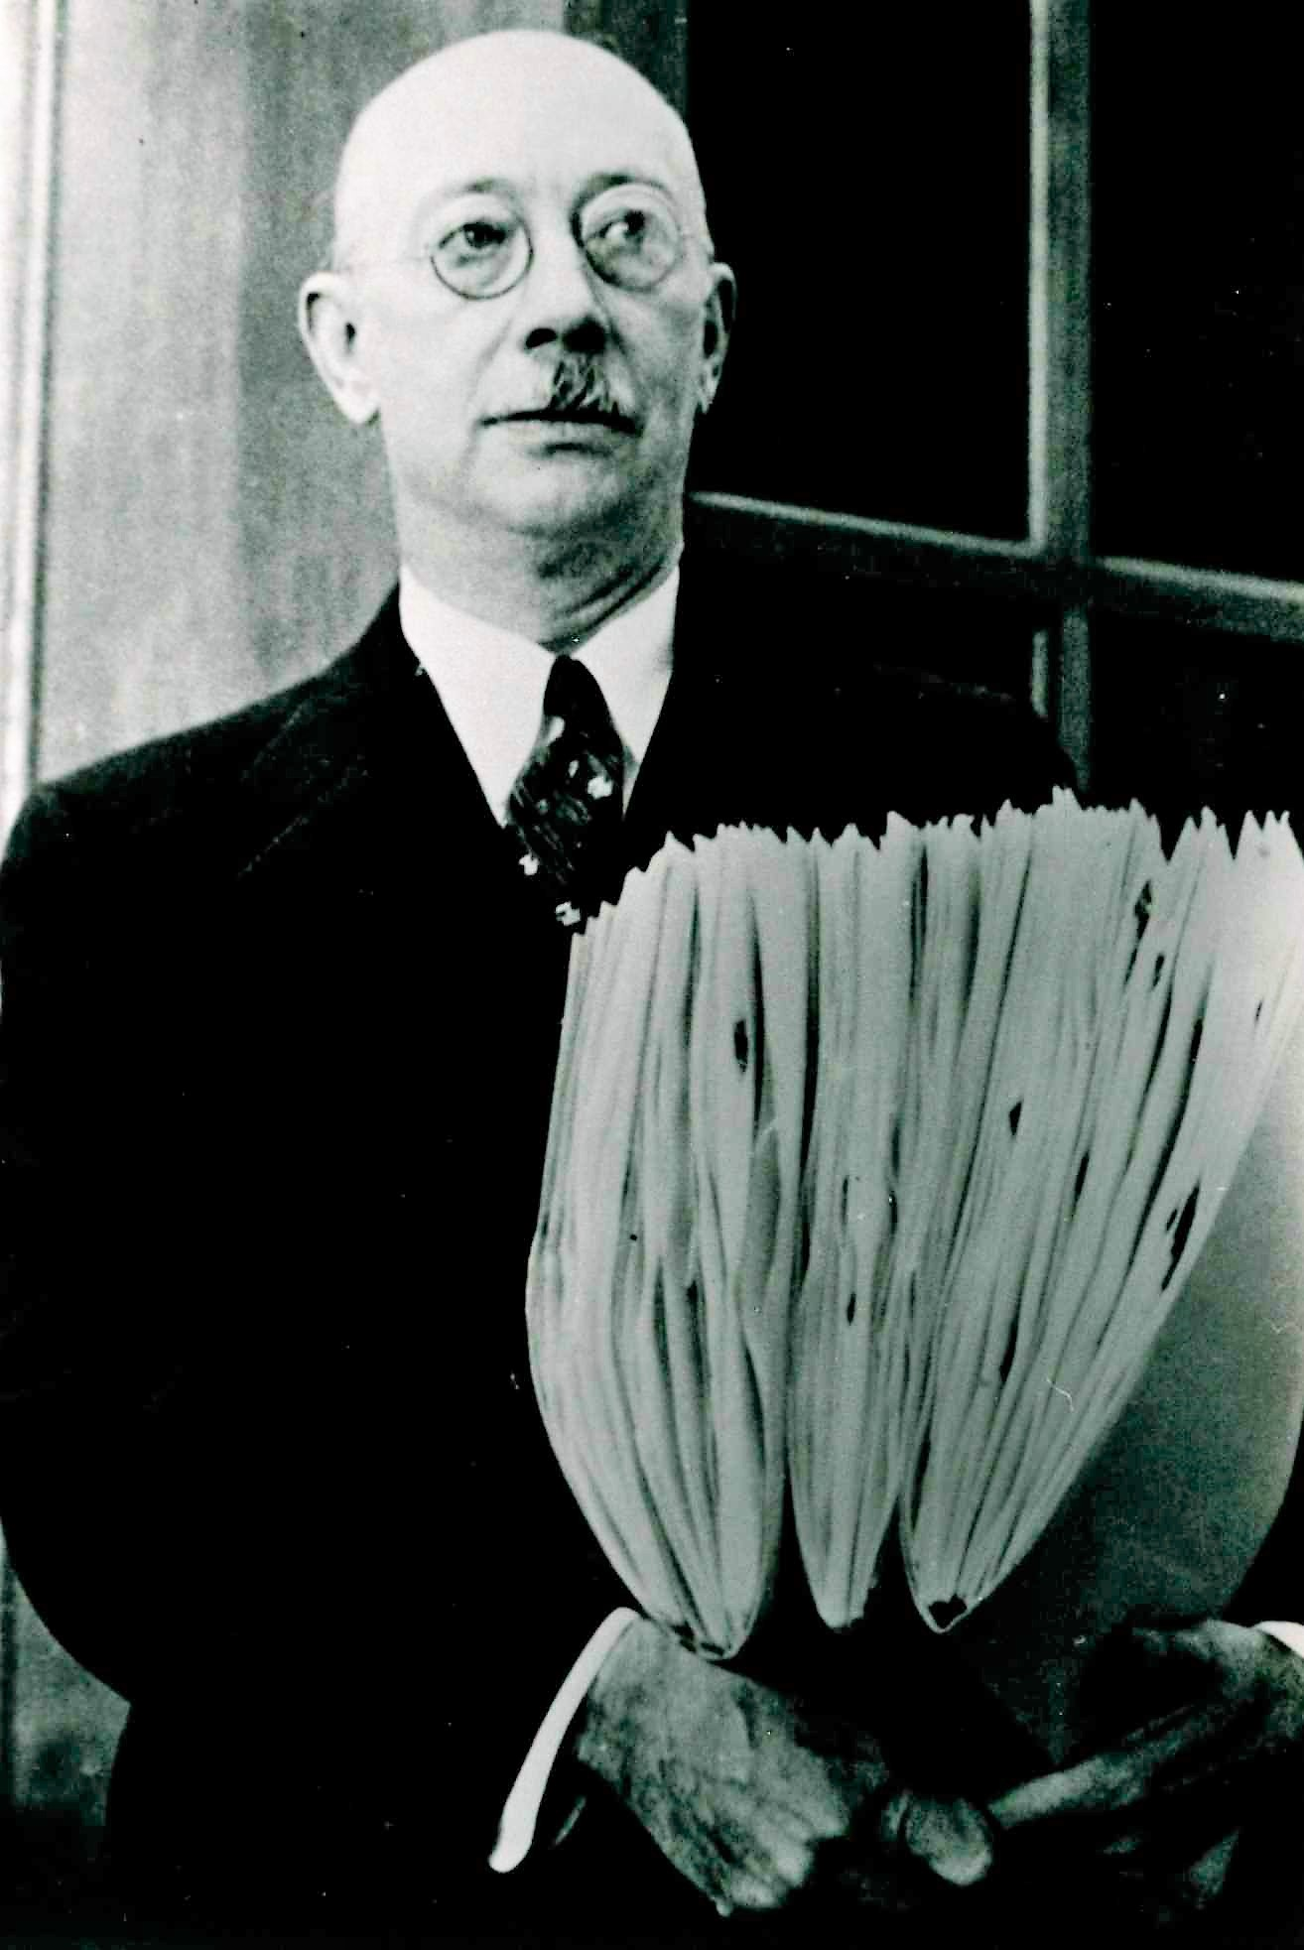
Distributions along gradients
Communities are “integrated”
Clements
Gleason
Communities are “individualistic”

Slide 14
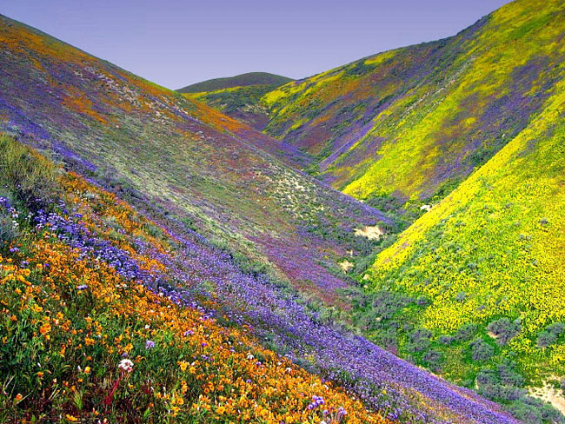

Slide 15
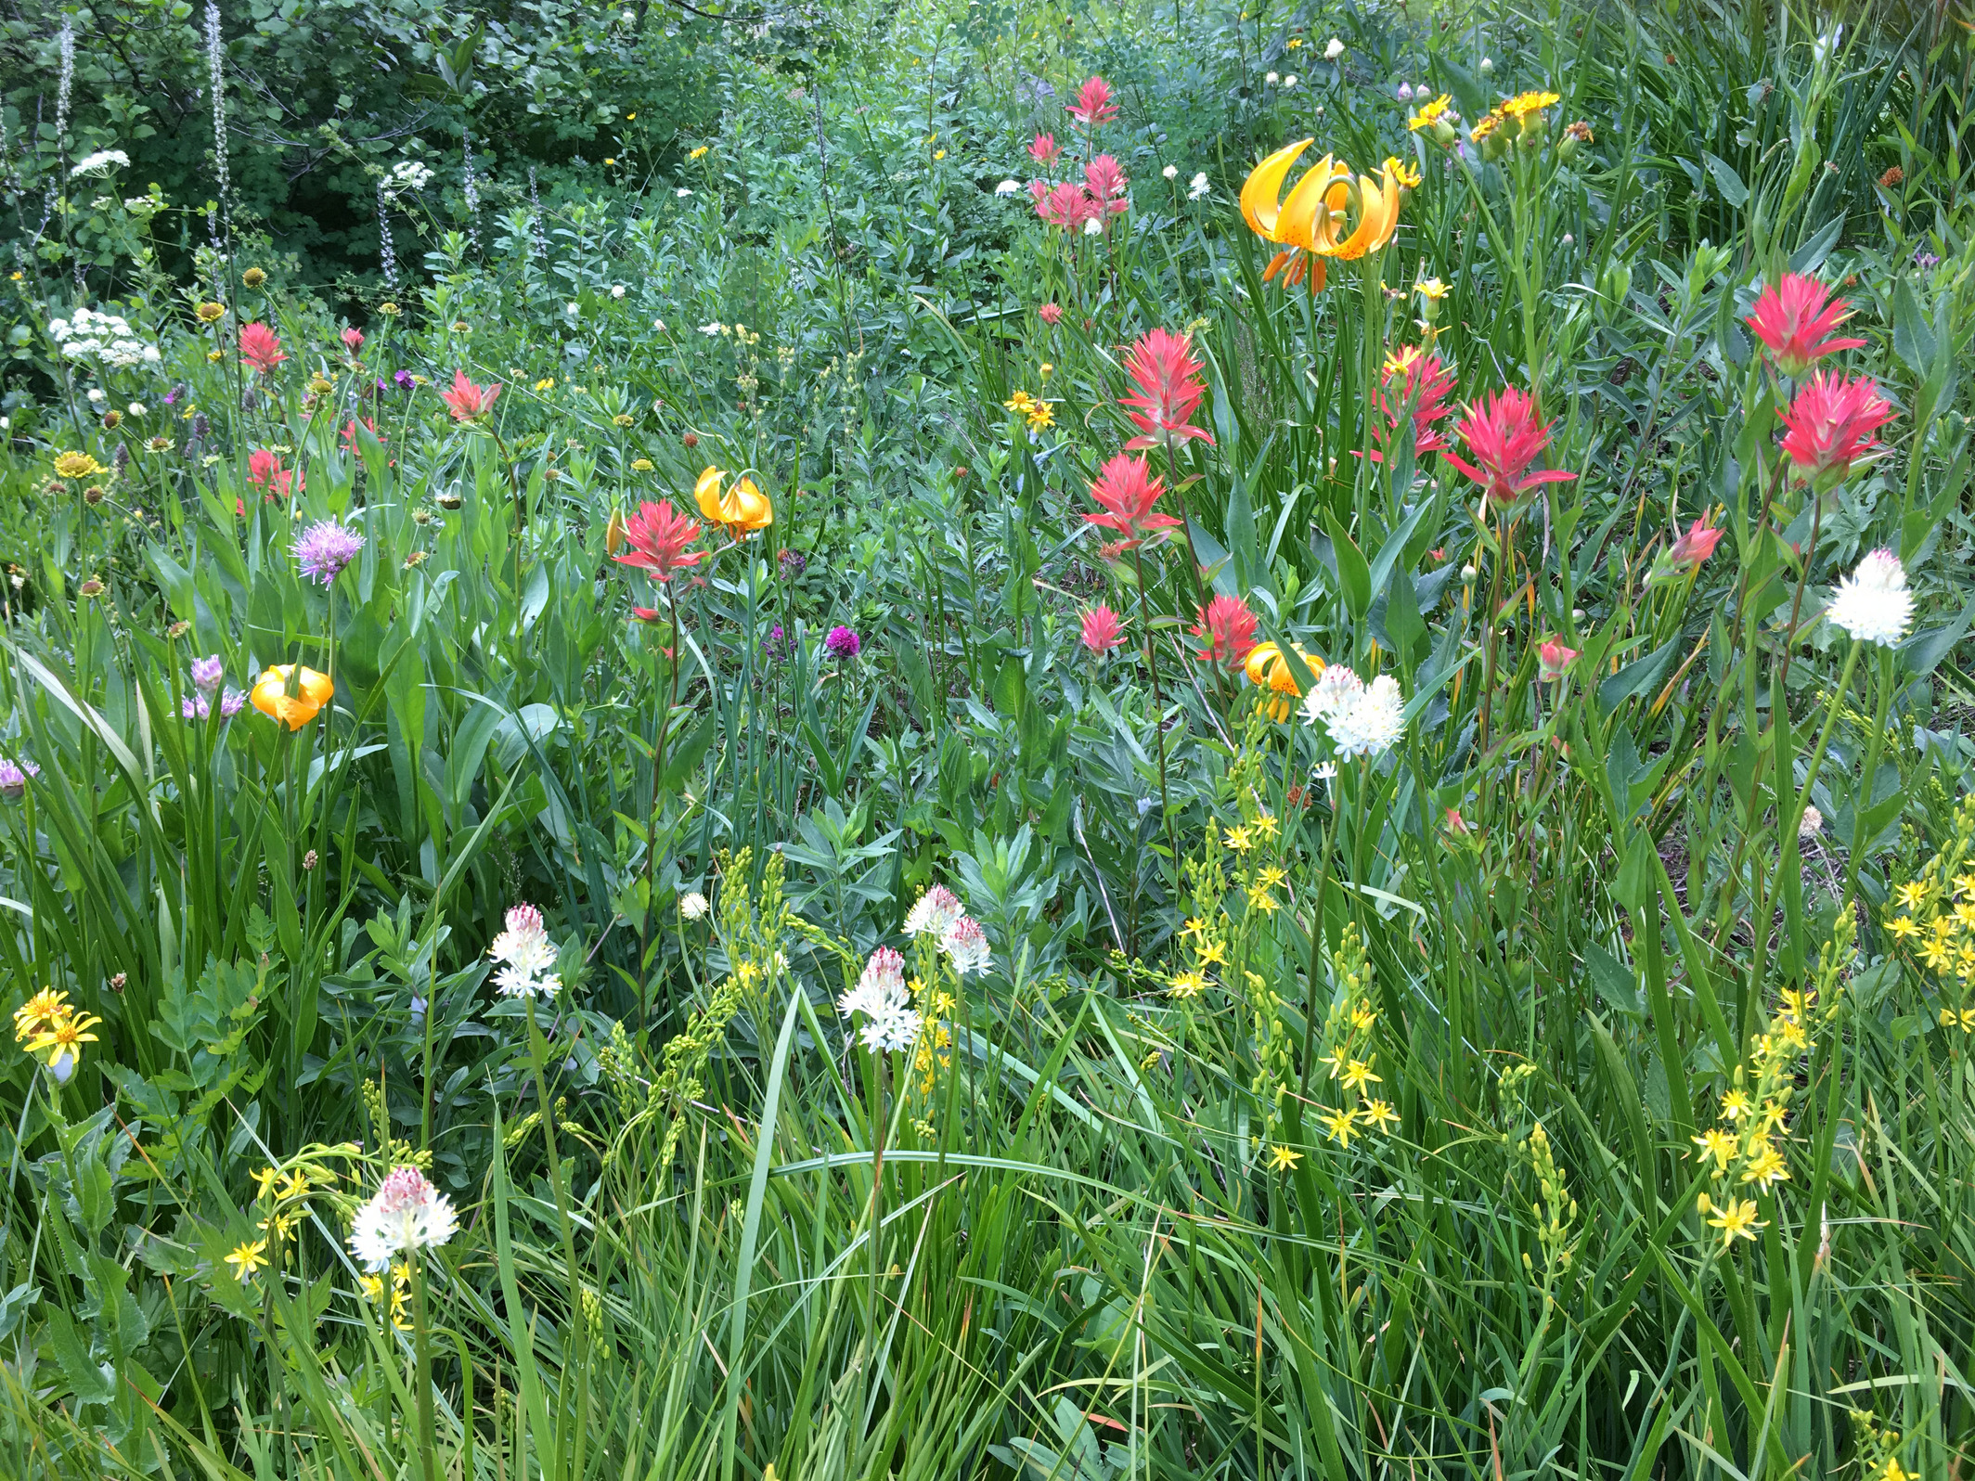
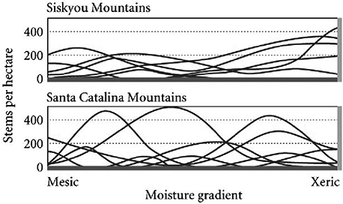
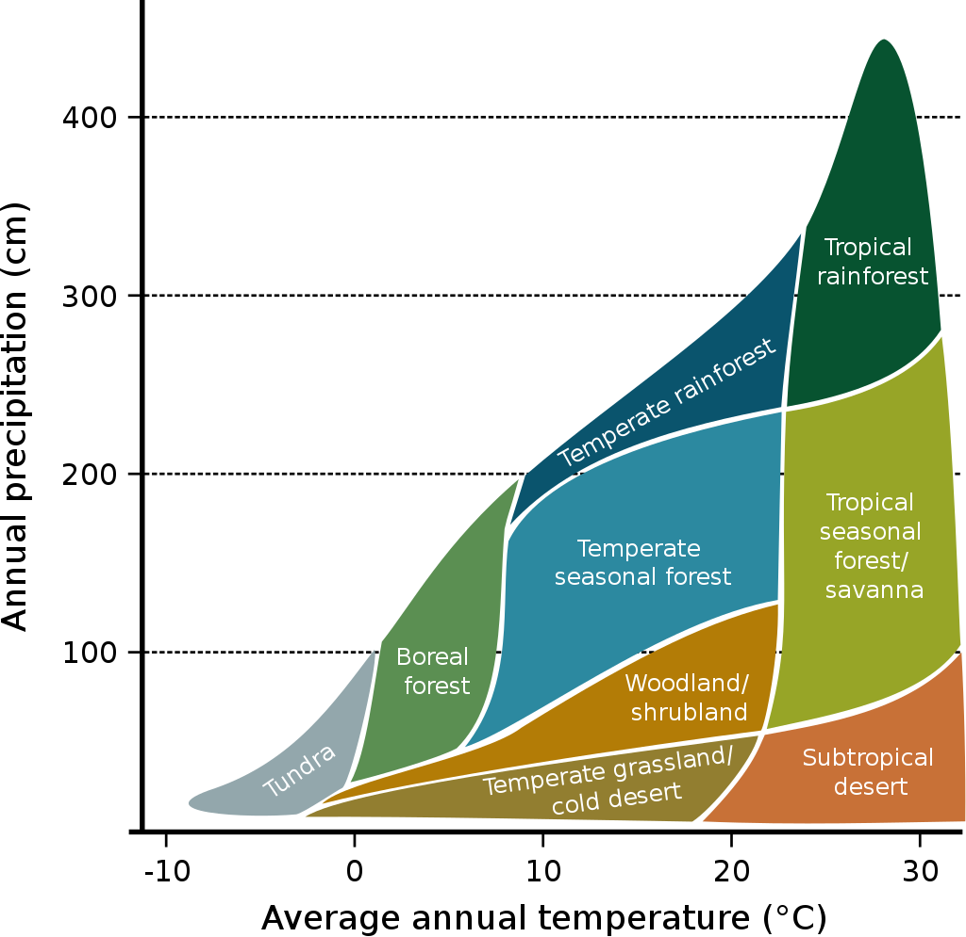
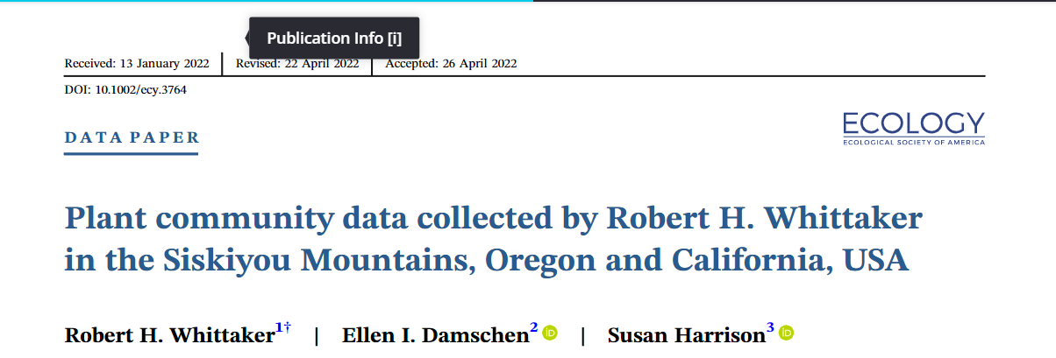
Whittaker 1950s-1960s—Beta diversity to examine gradients
Scale—Whittaker’s Biomes

Slide 16
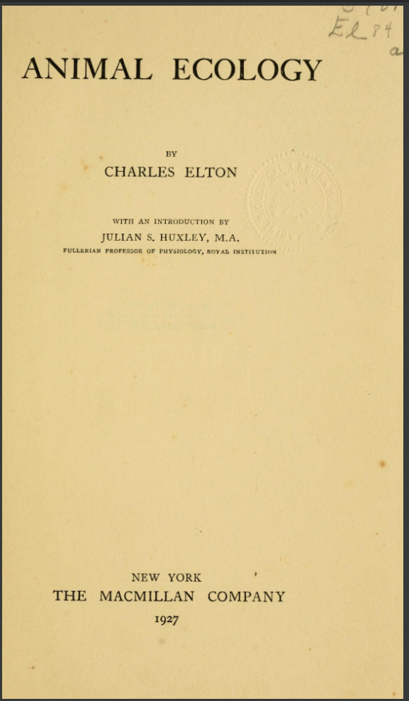
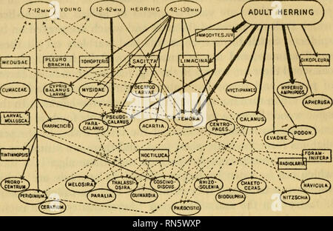
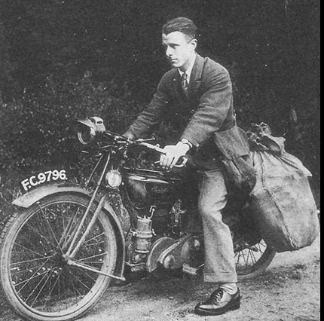
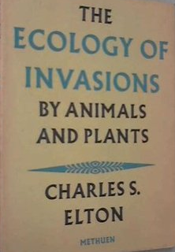
Food webs
Niche
Biodiversity and Ecosystem Functions
Invasive species (1958)
1927

Slide 17
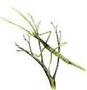
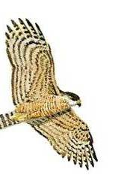
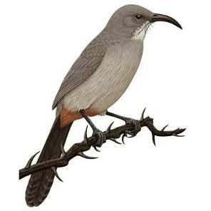
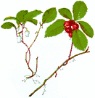
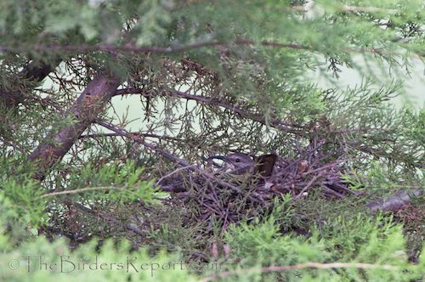
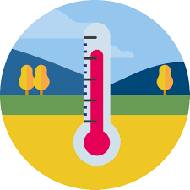

A Brief History of the (Ecological) Niche Concept
Niche
Factor Y
Factor Z
Factor X
N-dimensional hyper-volume
Grinnell (1917)→ Elton (1927)→ Hutchinson (1957)

Slide 18
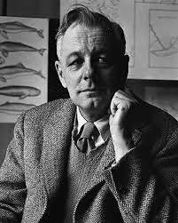
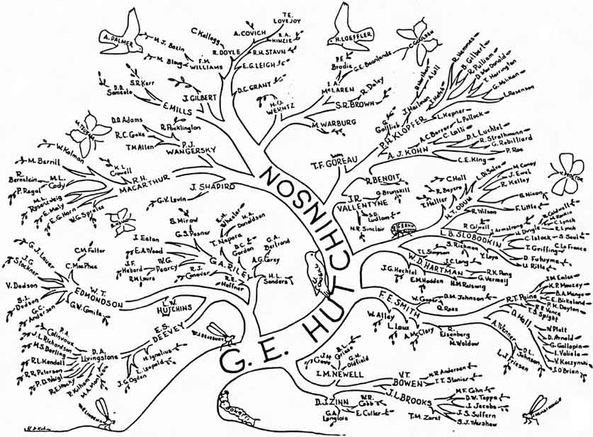

The ‘Golden Age’ of Community Ecology
1960s-1970s

